Slide 1

Project Title - Seasonal Agriculture Performance Analysis
Student Name- Rudrajit Pal
College Name- Future Institute of Engineering and Management
AICTE STU ID : STU69ed15baa0e6f1777145274

Slide 2

PROBLEM STATEMENT
Agricultural activities are influenced by seasonal variations in environmental conditions, farming practices, resource availability and market conditions. As a result, agricultural performance may differ from one season to another.
However, raw agricultural data does not clearly explain how agricultural performance changes across seasons or what patterns can be observed in different seasonal conditions.
The problem is to analyse the given agricultural dataset and investigate seasonal differences in agricultural performance by identifying meaningful patterns, trends, relationships and variations within the available data.

Slide 3
Project Description
Seasonal variations can influence different aspects of agricultural activities and performance. Understanding seasonal patterns through data analytics can help stakeholders:
Understand variations in agricultural performance
Identify important seasonal trends
Compare performance across different periods
Understand changing environmental conditions
Examine differences in resource usage
Identify areas requiring further investigation.

Slide 4

WHO ARE THE END USERS?
Farmers.
Agricultural planners.
Agricultural stakeholders.
Data analysts / researchers.
Agricultural Businesses & Market Analysts

Slide 5

Technology Used
Python – Data analysis and processing.
Pandas – Data cleaning and manipulation.
NumPy – Numerical operations.
Matplotlib – Data visualization.
Seaborn – Statistical visualizations
Google Colaboratory – Project development environment.

Slide 6
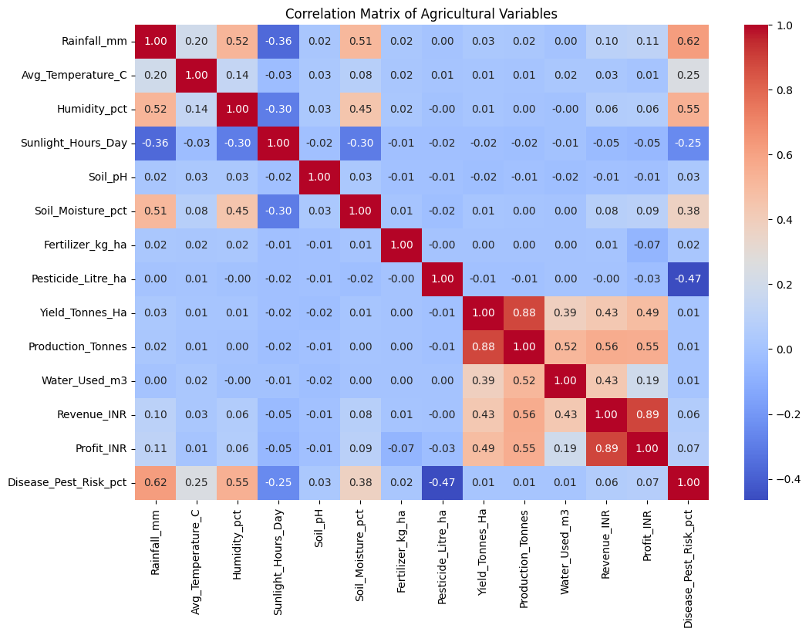
RESULTS
Yield and Production show a strong positive correlation (0.88).
Revenue and Profit have a strong positive correlation (0.89).
Rainfall and Disease/Pest Risk show a positive correlation (0.62).
Pesticide usage shows a negative correlation with Disease/Pest Risk (−0.47)

Slide 7
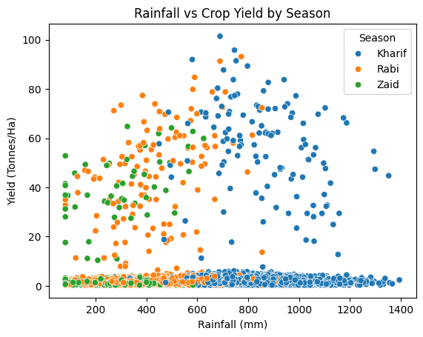
RESULTS
Yield varies across rainfall levels and seasons.
Kharif shows higher rainfall and several higher-yield observations.
Rainfall alone does not determine yield.

Slide 8
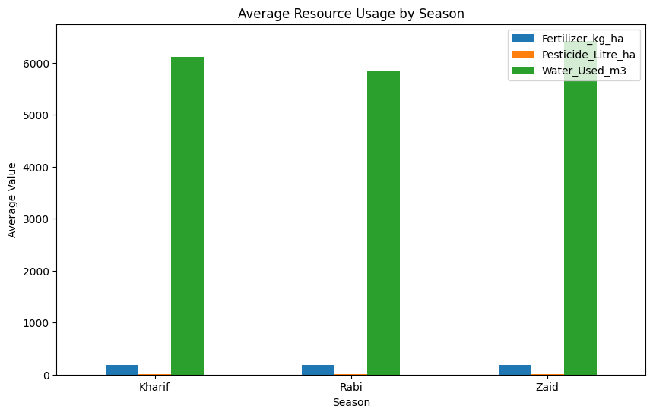
RESULTS
Water usage is highest in Kharif.
Zaid uses slightly more water than Rabi.
Fertilizer and pesticide usage are relatively similar across seasons.

Slide 9
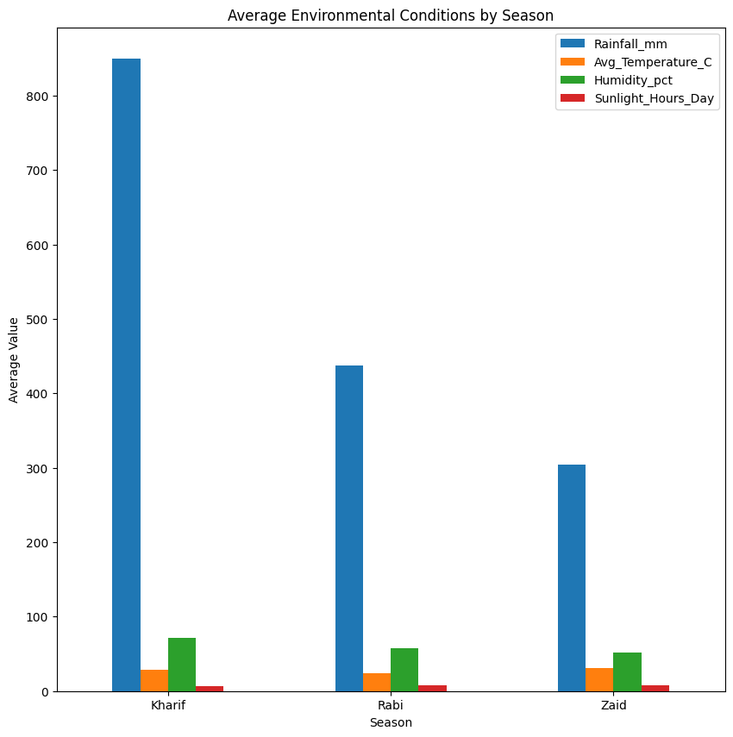
RESULTS
Kharif has the highest rainfall and humidity.
Zaid has the highest temperature and sunlight.
Environmental conditions vary clearly across seasons.

Slide 10
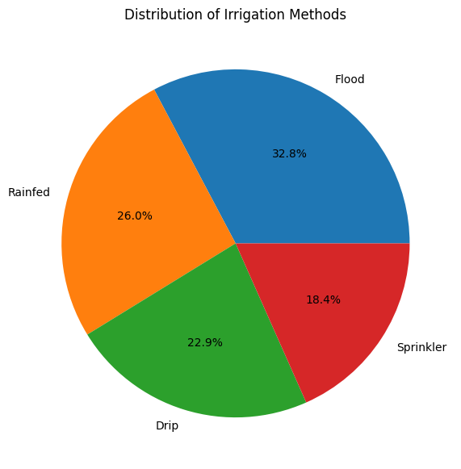
RESULTS
Flood irrigation is the most common method (32.8%).
Rainfed farming accounts for 26.0%.
Drip and Sprinkler account for 22.9% and 18.4%, respectively.

Slide 11
Future scope
Analyse long-term seasonal trends using historical agricultural data.
Develop predictive models for crop yield and profitability.
Improve water and resource management using data-driven insights.
Extend analysis to more regions, crops and environmental factors.
Build a decision-support system for better seasonal agricultural planning.

Slide 12
GitHub Link
https://github.com/rudrajit-pal/Seasonal-Agriculture-Performance-Analysis

Slide 13
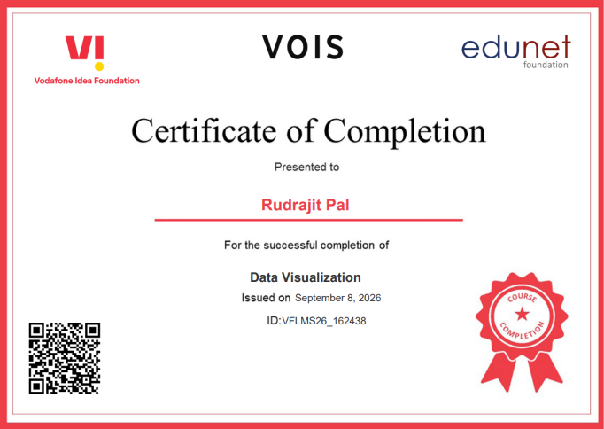
VOIS Course completion certificate - Course name- Data Visualization

Slide 14
Thank you
Seasonal insights for smarter and more sustainable agricultural planning.
.
.

